Slide 1

ONLINE INSURANCE MANAGEMENT SYSTEM

Slide 2


OUR TEAM
Puli Keerthi pavani venkata bhavani
Jupally Samhitha
Aditya Roy
Ramya D
Madduluru sai vikas

Slide 3

INTRODUCTION
This Online Insurance Web Application enables users to explore insurance services, check agent availability, request notifications for unavailable agents, and contact support directly through a contact form and book appointments seamlessly.
The platform features user authentication with login and registration forms, along with validation for secure data entry and an admin dashboard for efficient system oversight.
The project is built with Java, MySQL, and JDBC, offering a strong backend that efficiently manages data and ensures secure user interactions.
This project seeks to improve efficiency and customer satisfaction by providing a user-friendly platform for managing insurance needs with ease and accessibility.

Slide 4

PROJECT OVERVIEW
Customer Features :-
User Authentication
Contact agent
Appointment Booking and Cancellation
Appointment Management
Insurance Plan
Administration Features:-
Admin Dashboard
Agent Management
Plan Information Management

Slide 5

MILESTONES
1. Foundation Setup Successfully implemented user authentication and registration, laying the groundwork for the agent availability management module.
2. Enhanced Agent Interface Delivered a comprehensive agent availability management system, introduced an intuitive appointment scheduling interface, and initiated seamless backend integrations.
3. Streamlined Appointment Management Developed and integrated a robust appointment management system for users, bridging the gap with backend functionalities while enhancing agent-related features.
4. Administrative Advancements Finalized agent functionalities and began working on the admin dashboard, introducing features for efficient management and streamlined operations.

Slide 6
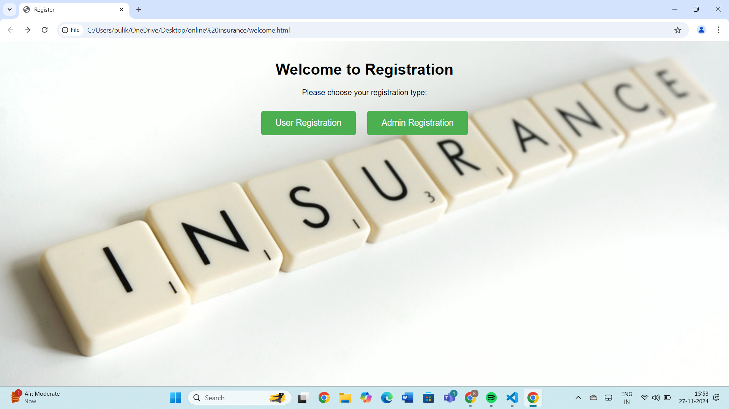
WELCOME PAGE
This is the welcome page.
Which shows user registration and admin registration

Slide 7
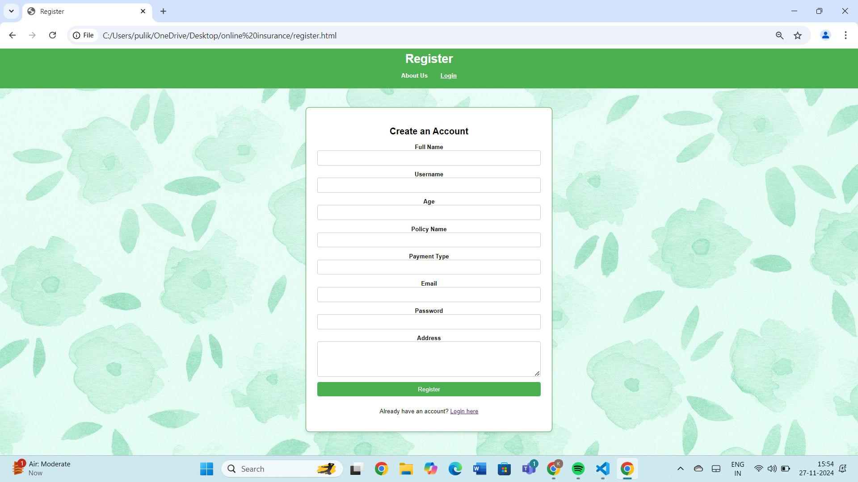
REGISTRATION PAGE
Registration page with strict validation,that age should between 18 to 100
Password must contain a capital letter,small letter,number and a special character

Slide 8
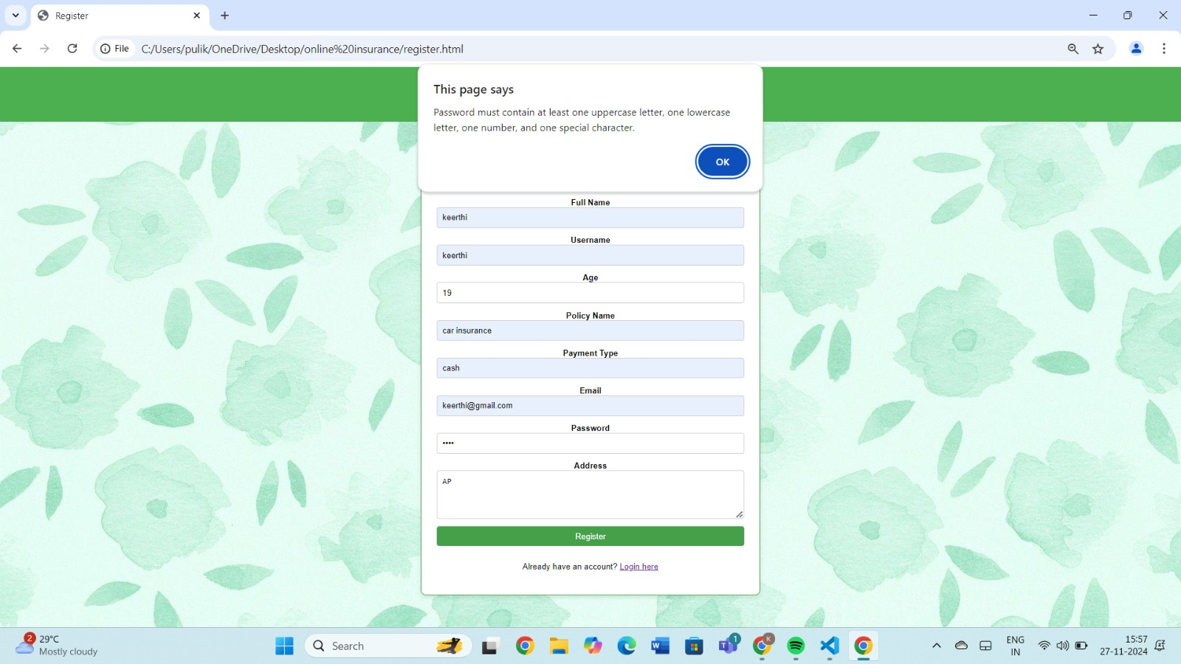
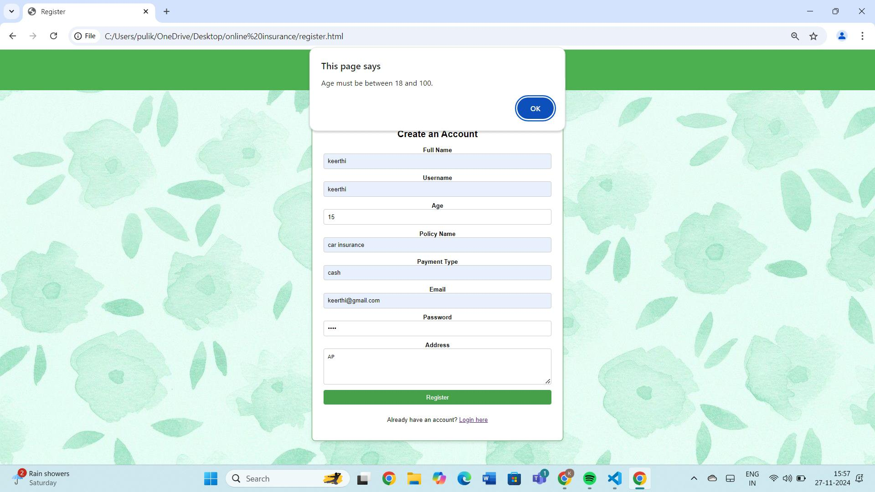
If we gave 3456 as passwords it shows.
If we gave 15 as age.

Slide 9
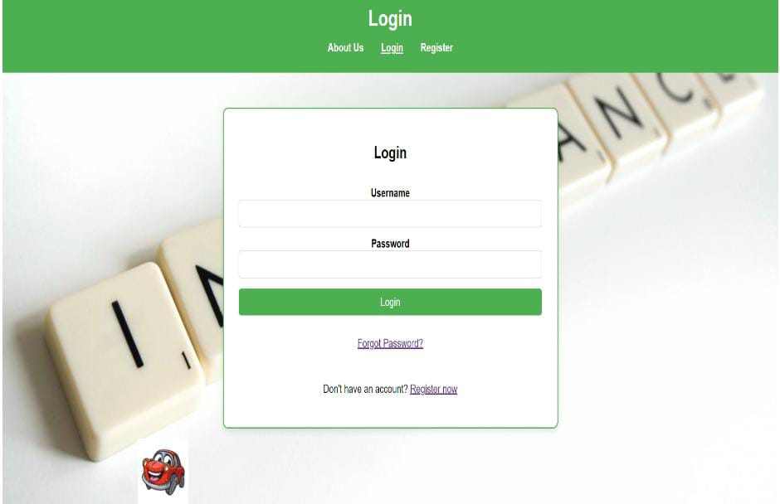
LOGIN PAGE
Login page:user can login in by providing their username and password .
By clicking on login,it will display the home page

Slide 10
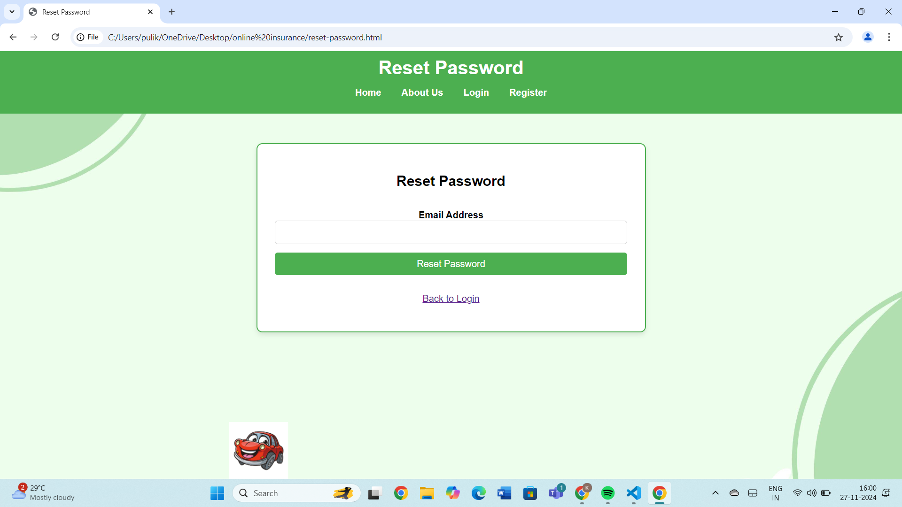
RESET PASSWORD PAGE
If user forget password they can reset it using their email id

Slide 11
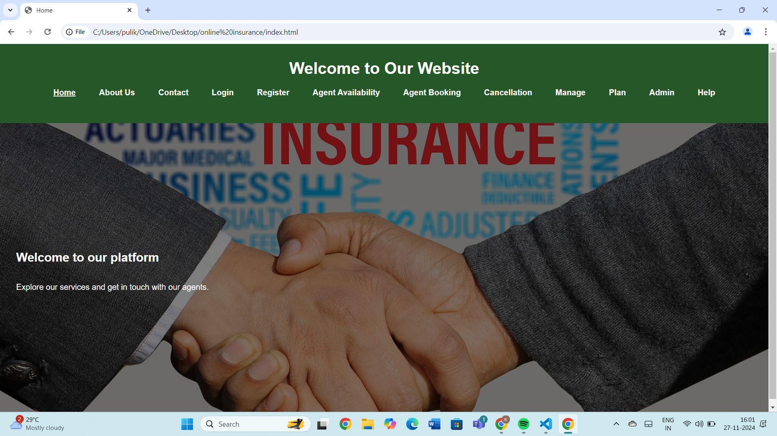
HOME PAGE
This is the Home page.
Which shows all the features of website.

Slide 12
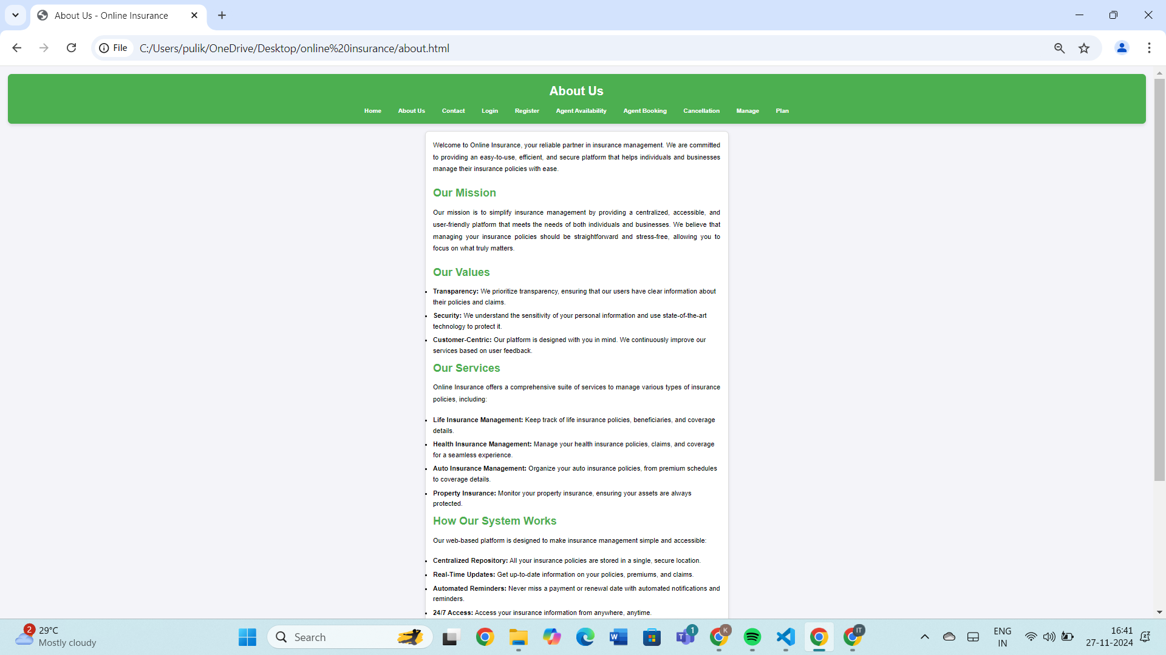
ABOUT US PAGE:
This page tells about the website,
missions, values,
services and how the system works

Slide 13
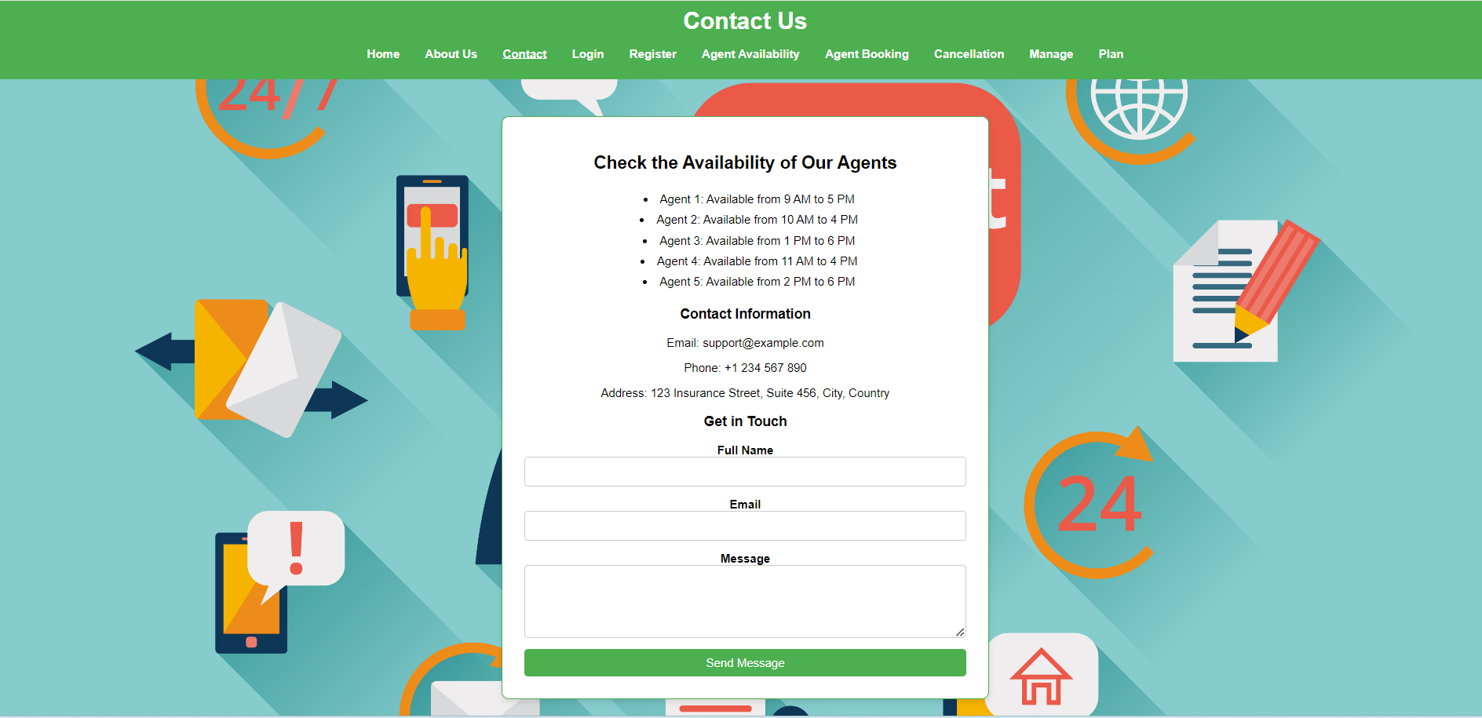
CONTACT PAGE
There is a dedicated contact page for user for contacting the agents

Slide 14
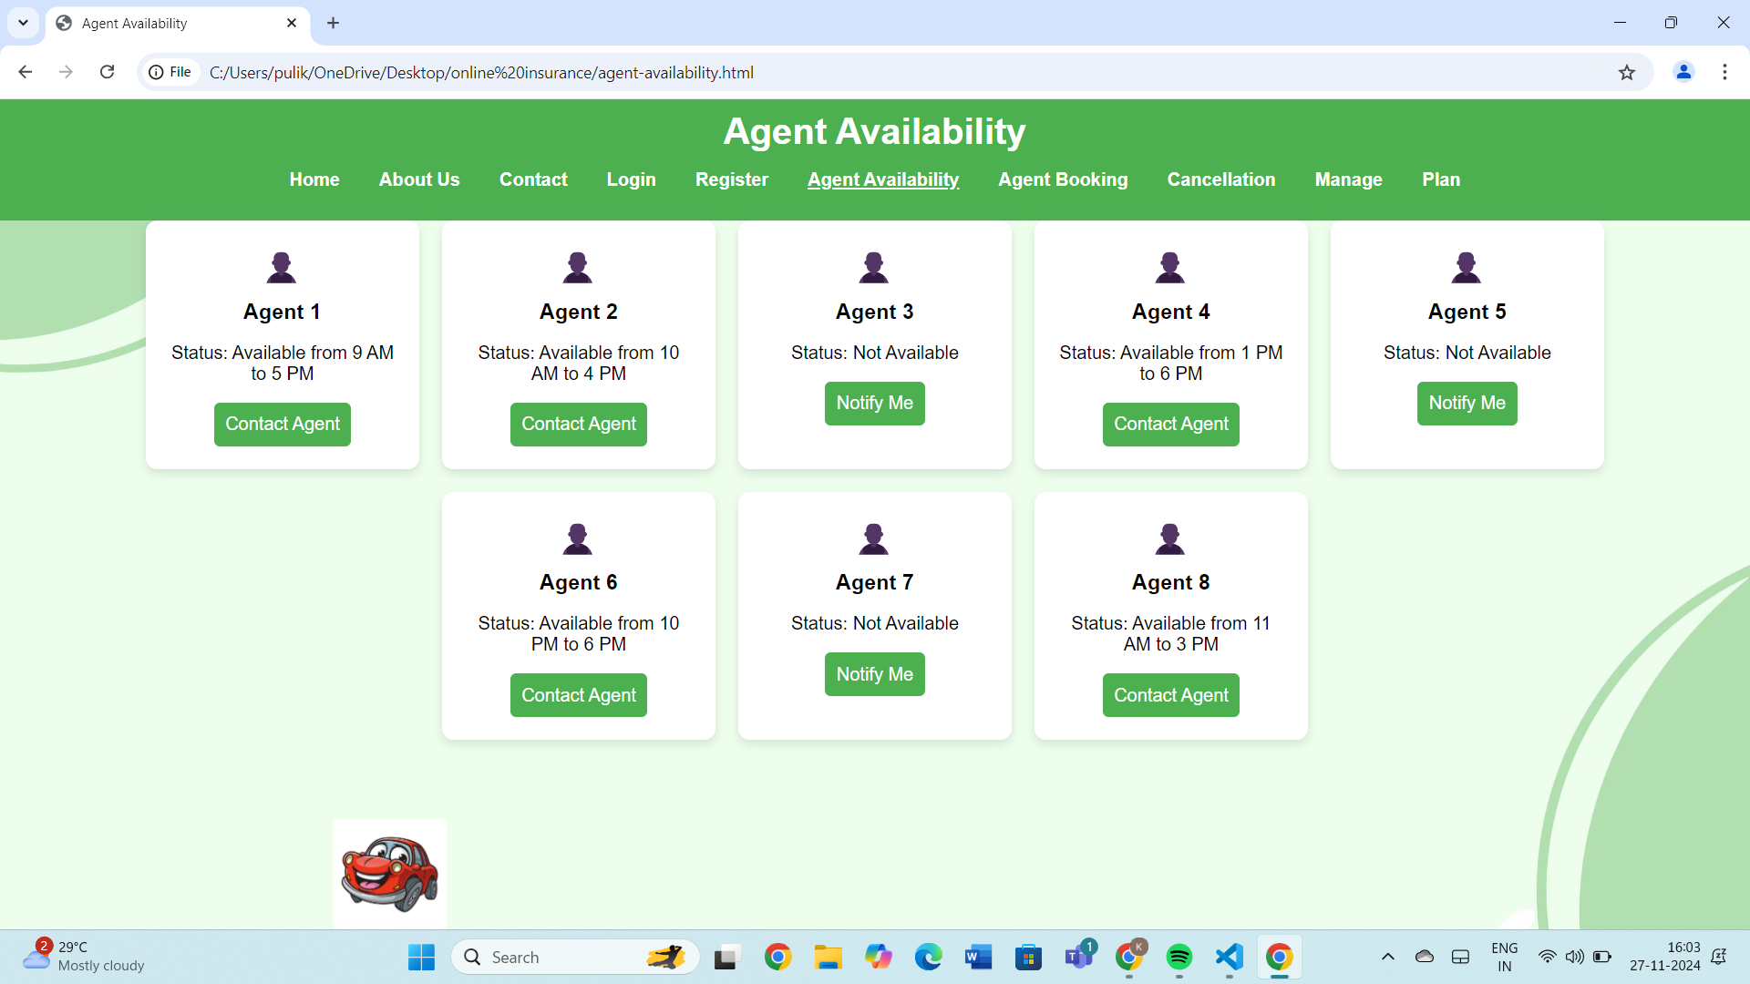
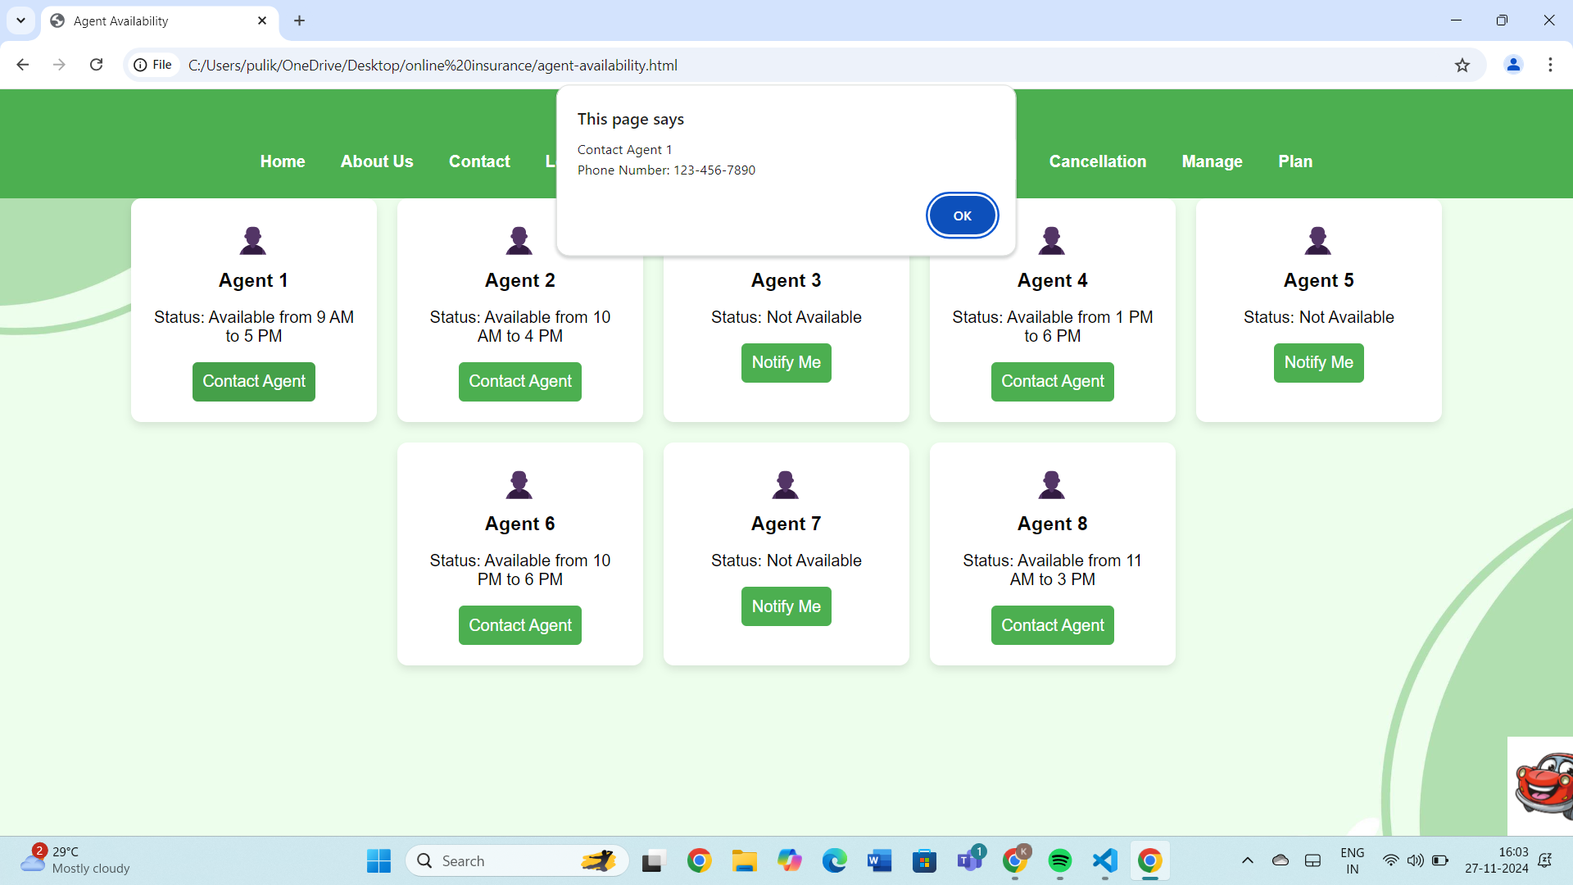
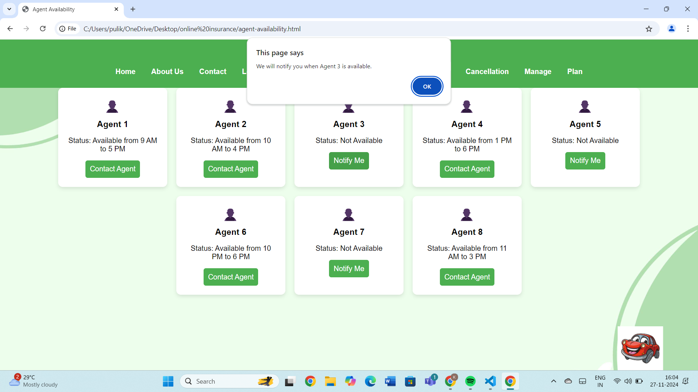
AGENT AVAILABLITY
User can check out for availability of agents if they are available user can contact them.
If they are not available they can click on NOTIFY button.

Slide 15
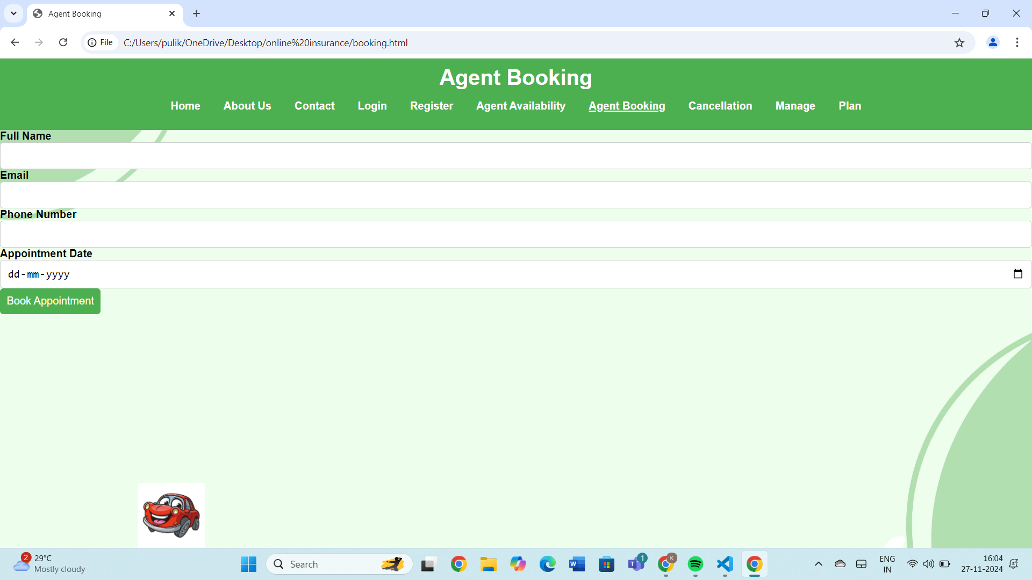
AGENT BOOKING
User can Book an Agent by our Booking Agent page .
By providing name , email , phone number and the date we booked the appointment

Slide 16
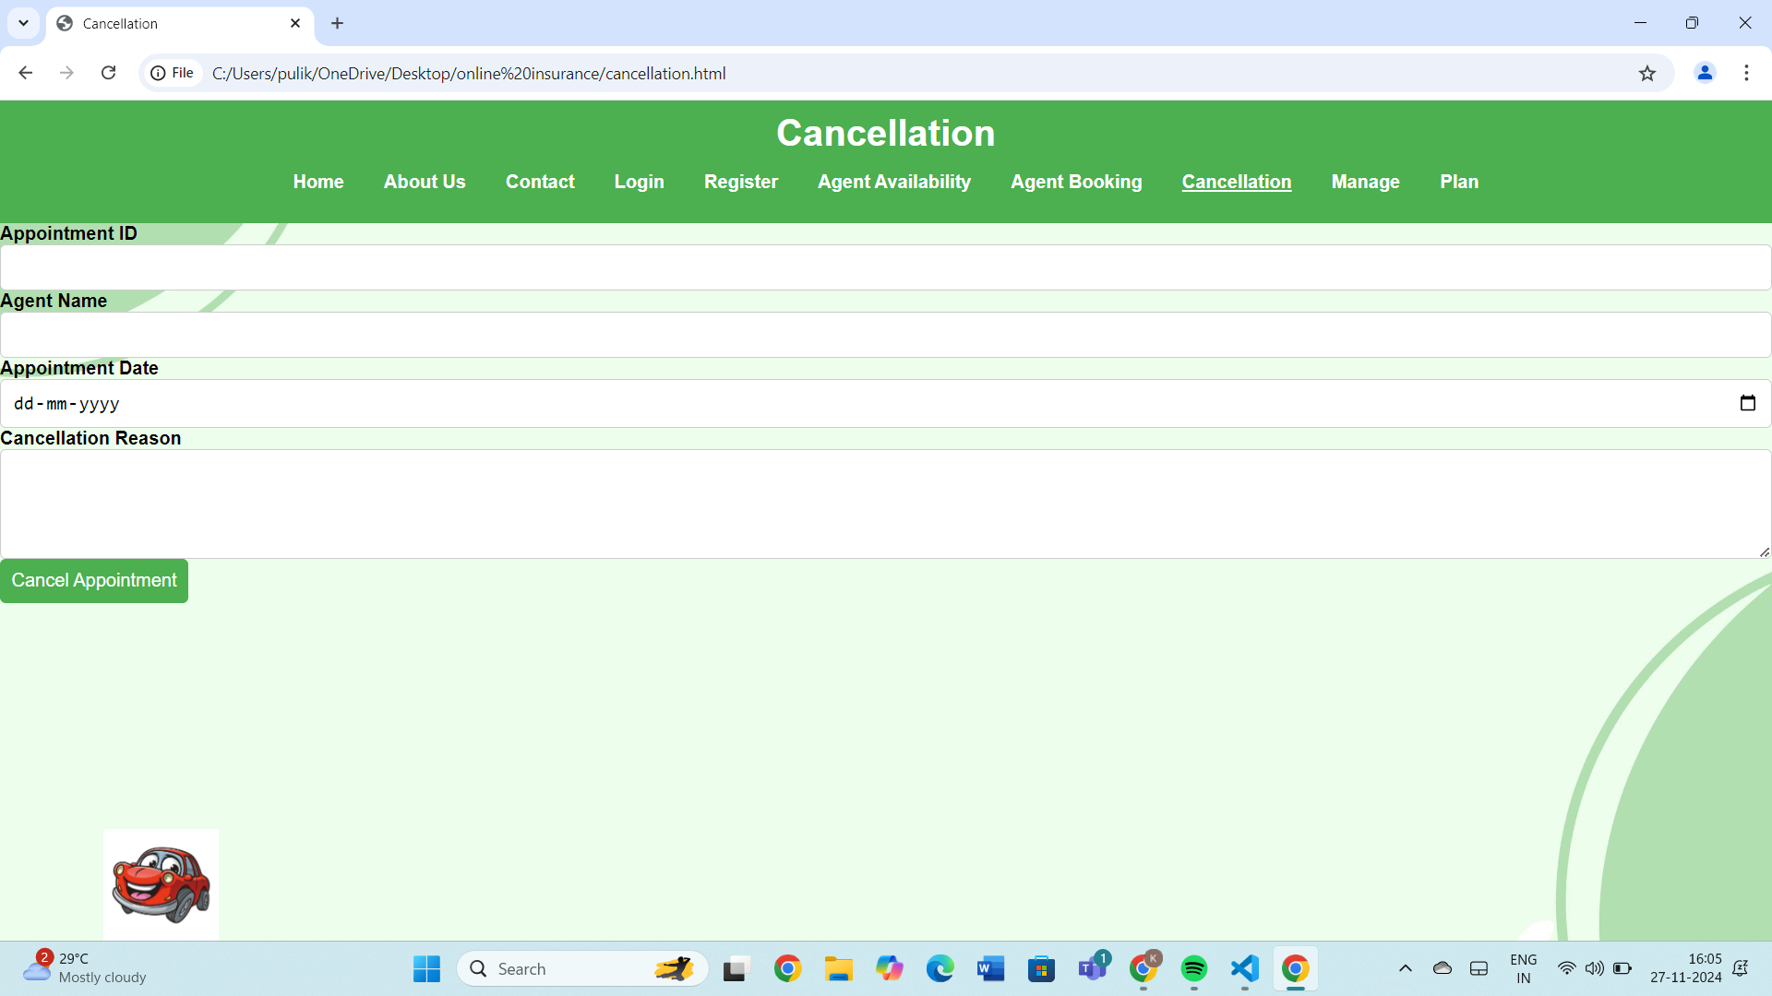
AGENT CANCELLATION
User can CANCEL there booking with an Agent by our cancellation page.
You need to provide appointment id,agent name and appointment date and reason for cancellation

Slide 17
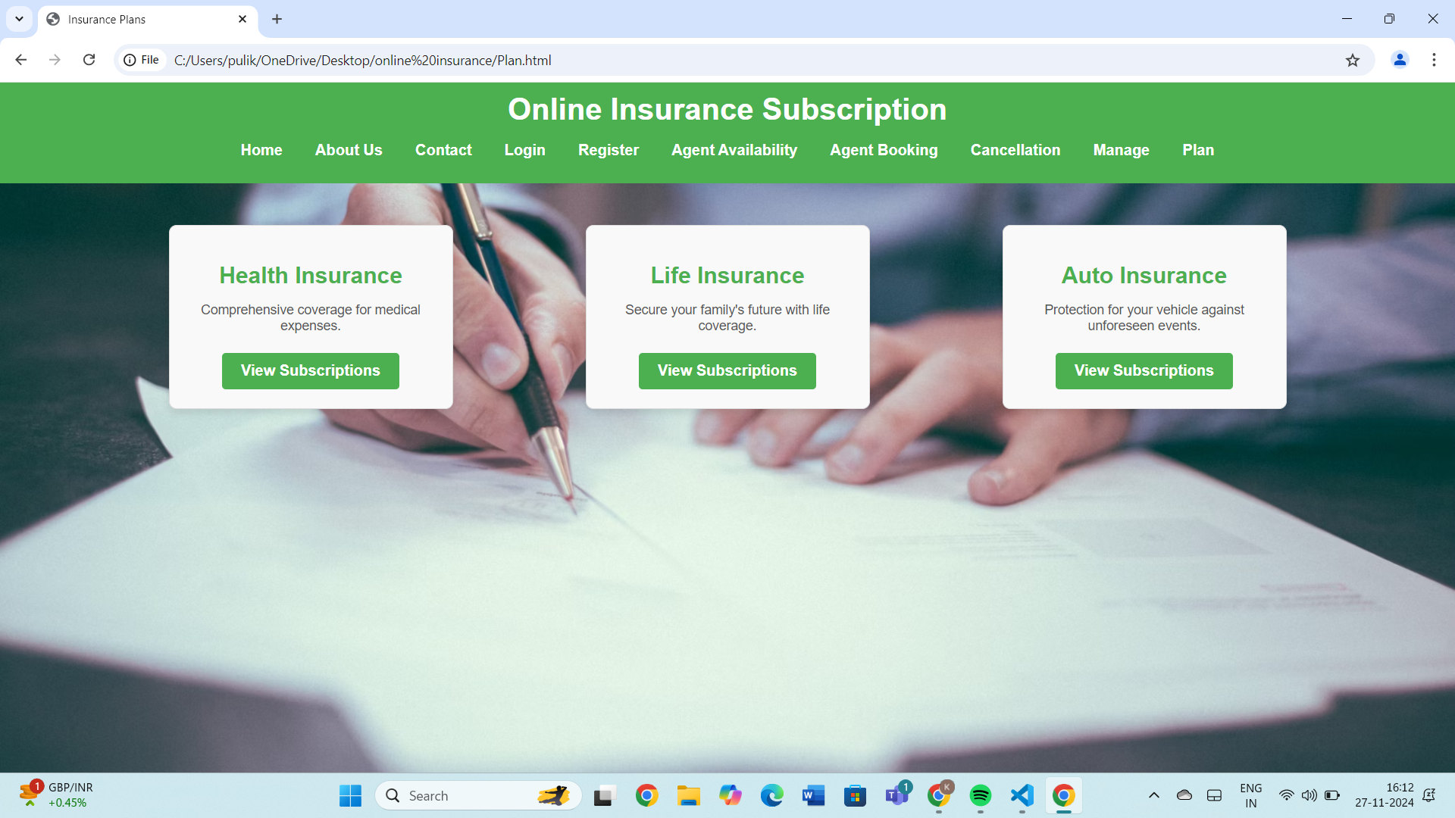
PLAN MANAGEMENT
This is the PLAN management page , where the user have different type of Insurance Plan are available.

Slide 18
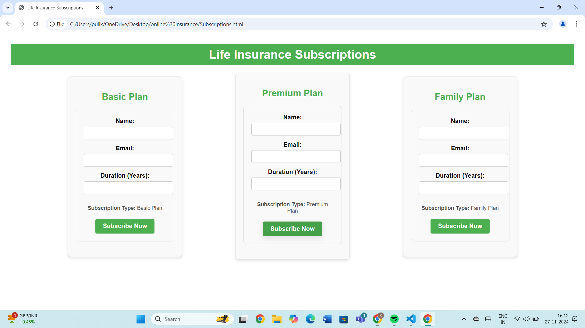
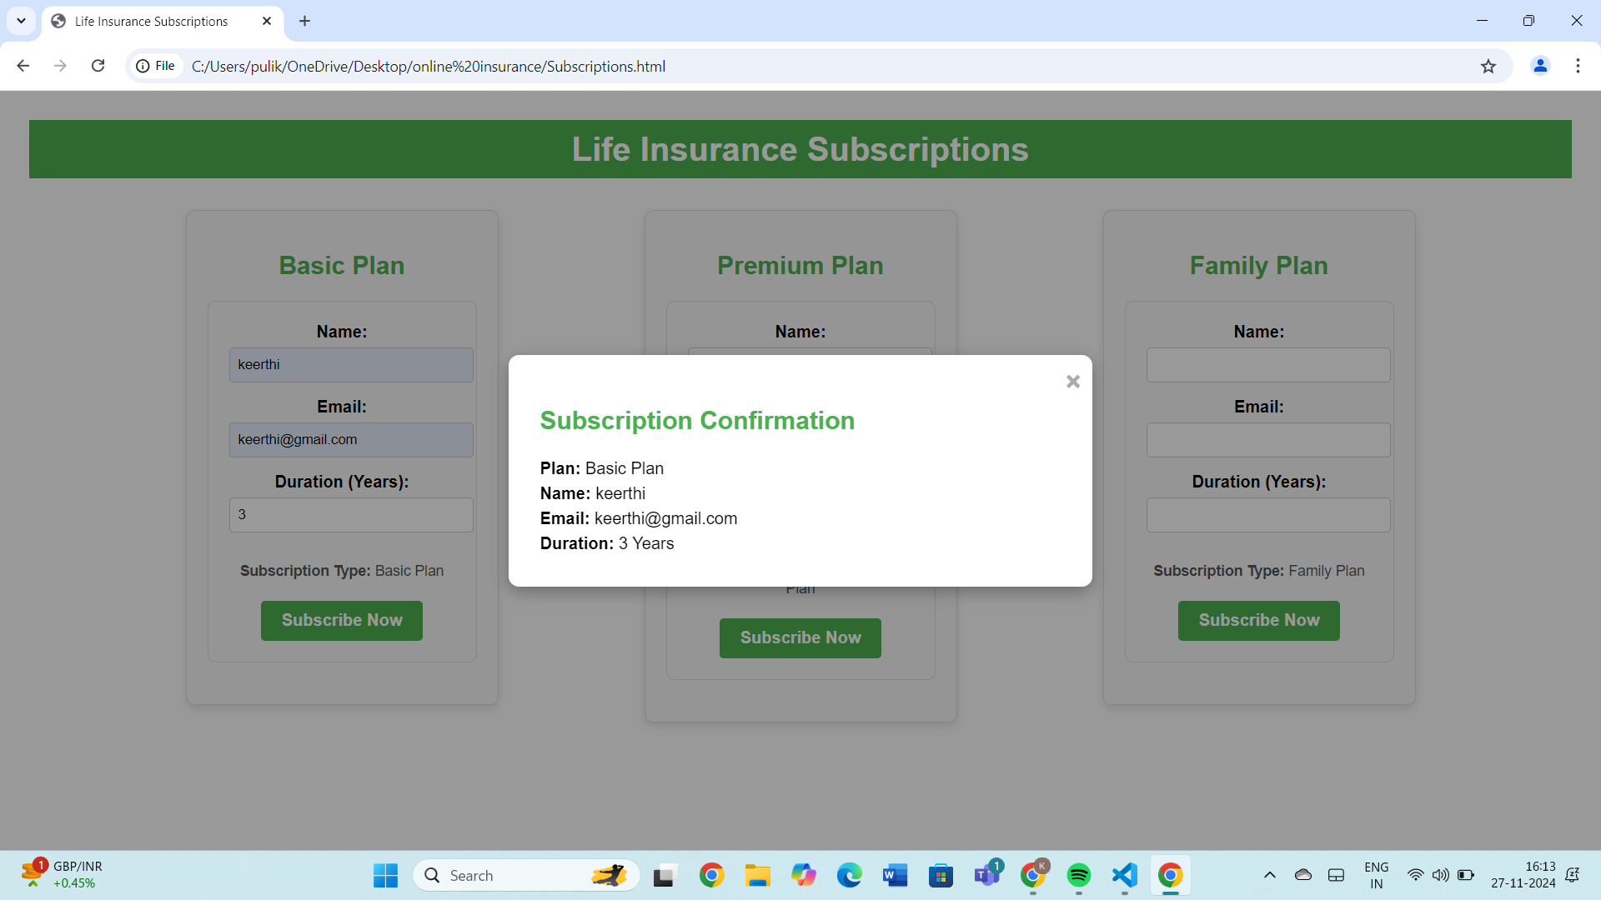
SUBSCRIPTION
In the subscription page 3 types of subscription option available for users.
After filling out the there details and clicking on subscribe now they will get confirmation Notification of there plan

Slide 19
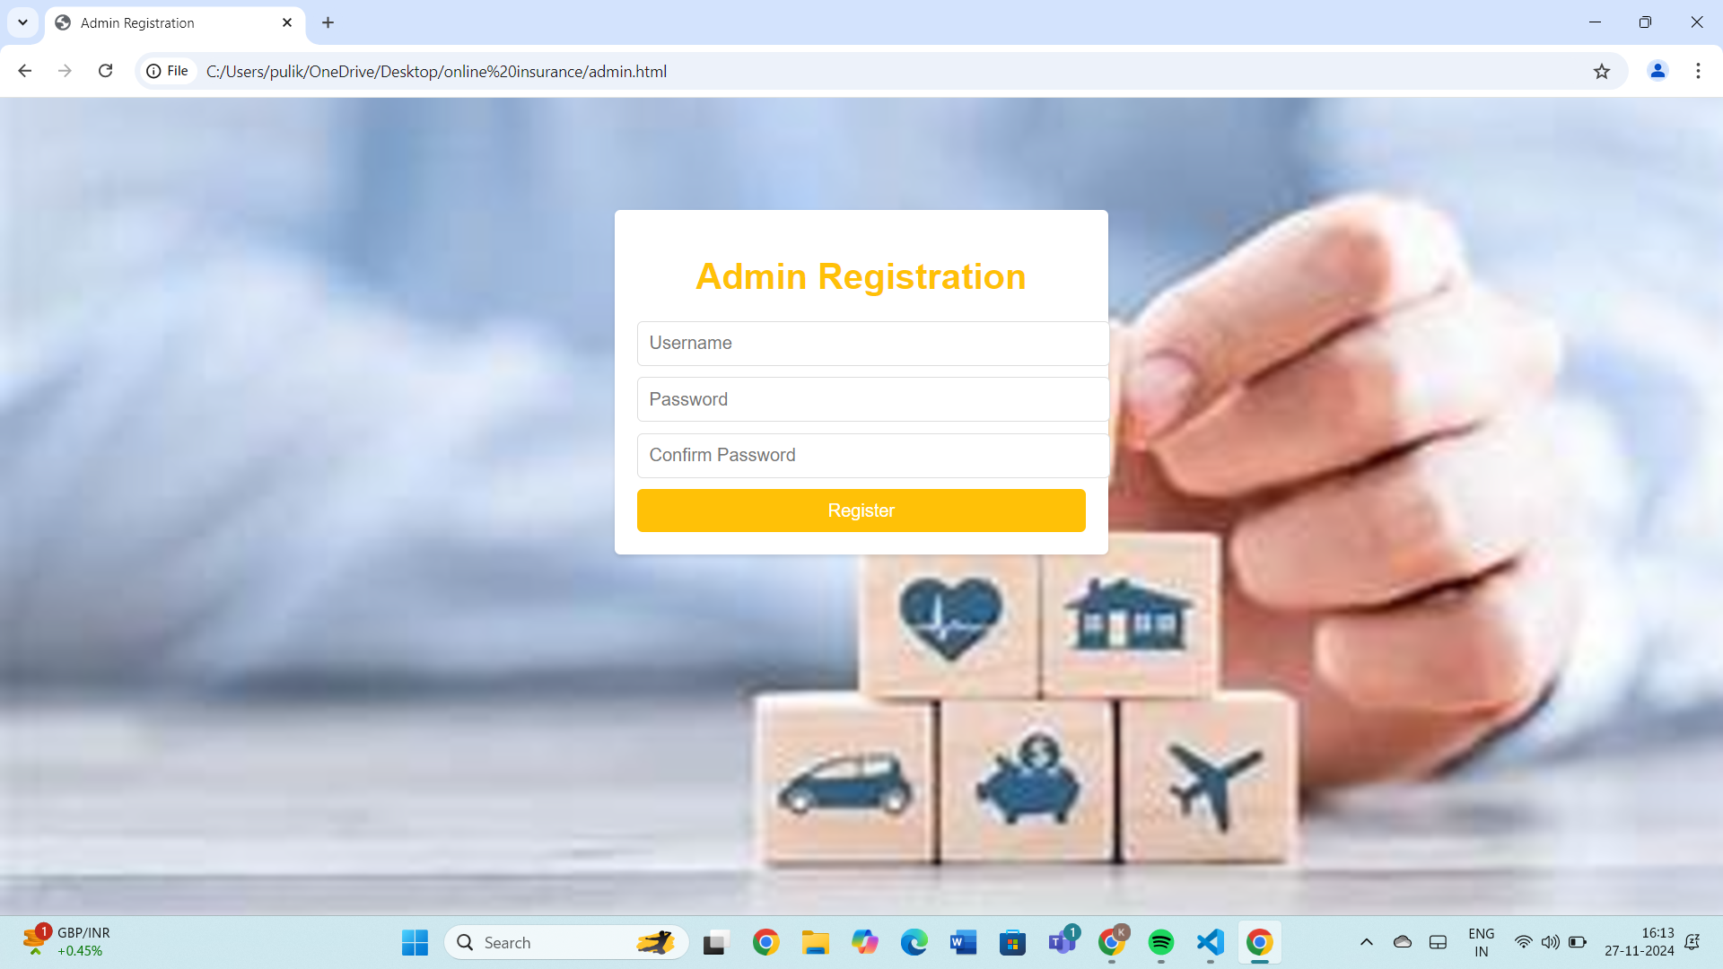
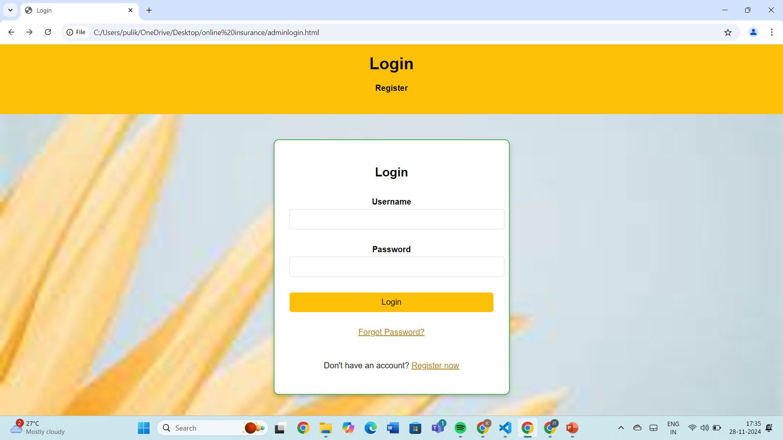
ADMIN REGISTRATION
This is admin Registration page where they can register by giving there Username and password.
This is admin Login page where they can login by giving there Username and password.

Slide 20
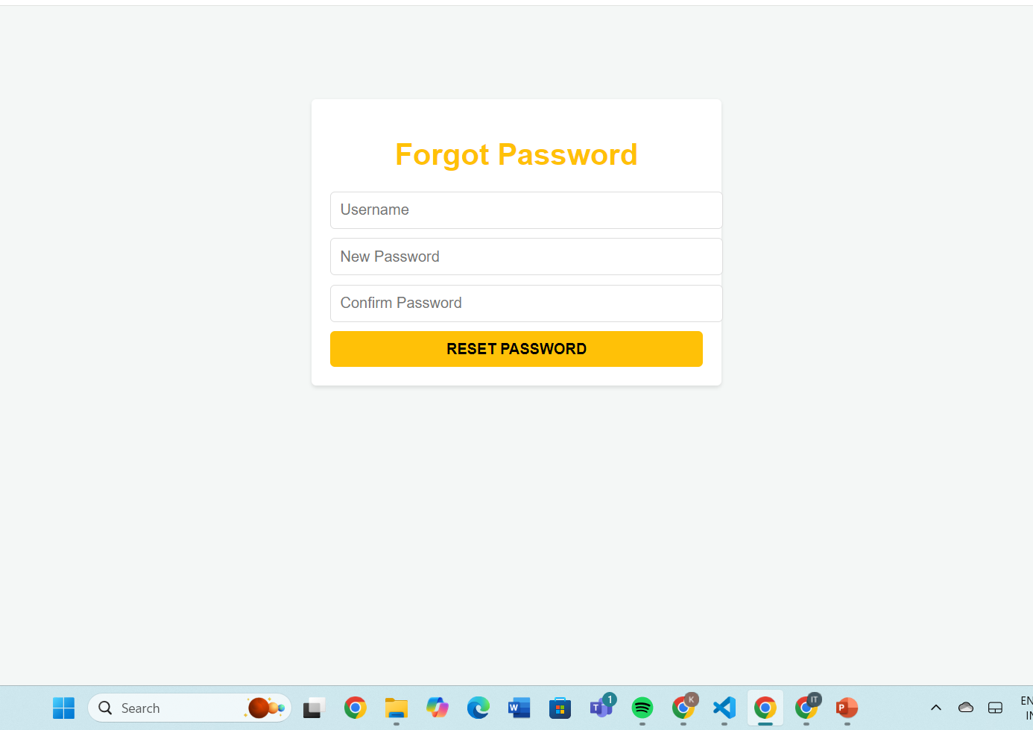
ADMIN PASSWORD RESET.
If ADMIN forgot there password they can reset it by using Forgot Password option.
Need to provide their username and the new password that they are resetting

Slide 21
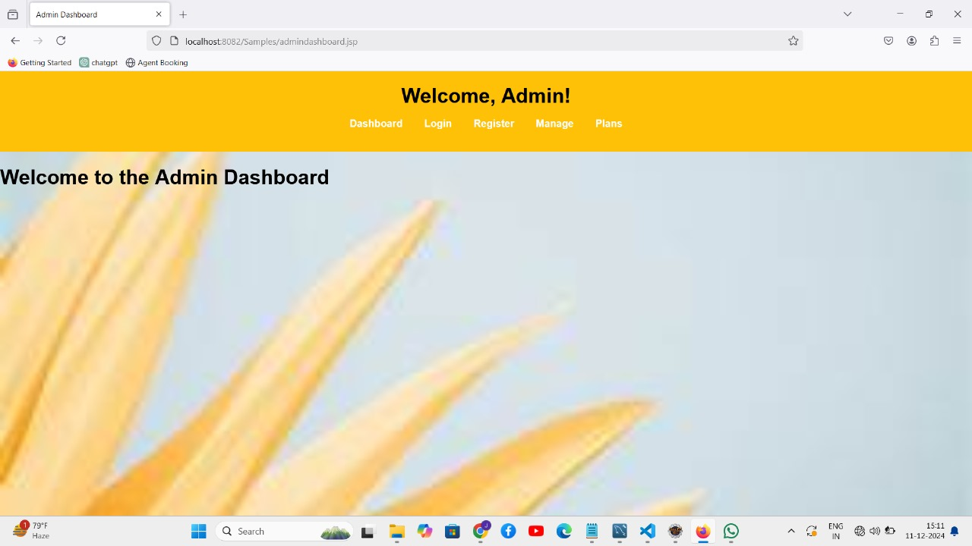
ADMIN DASHBOARD
This is the ADMIN welcome page , where different features are available.
Where admin can manage users, agents ,plans , appointments and can view reports

Slide 22
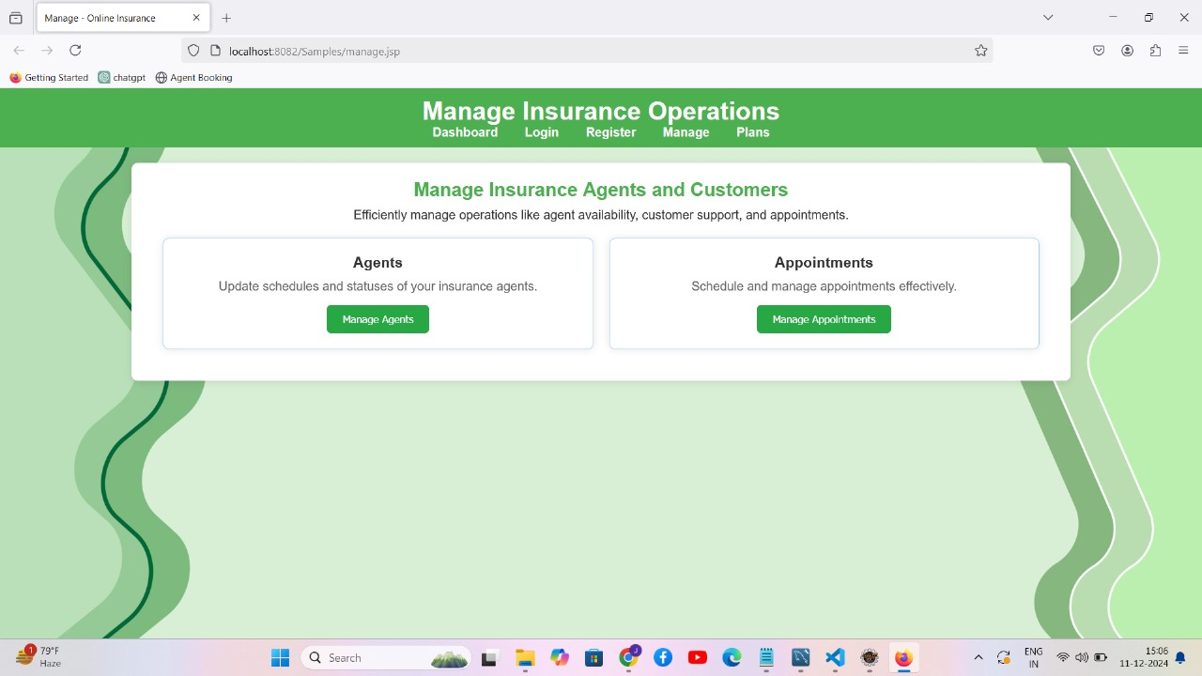
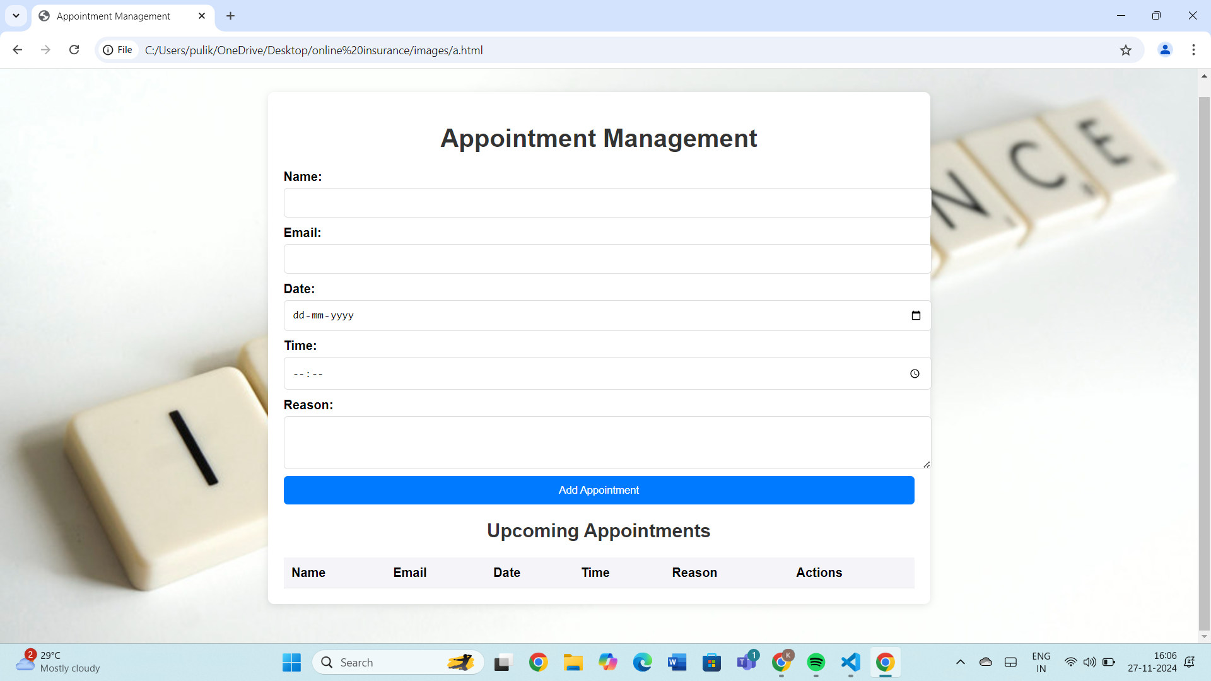
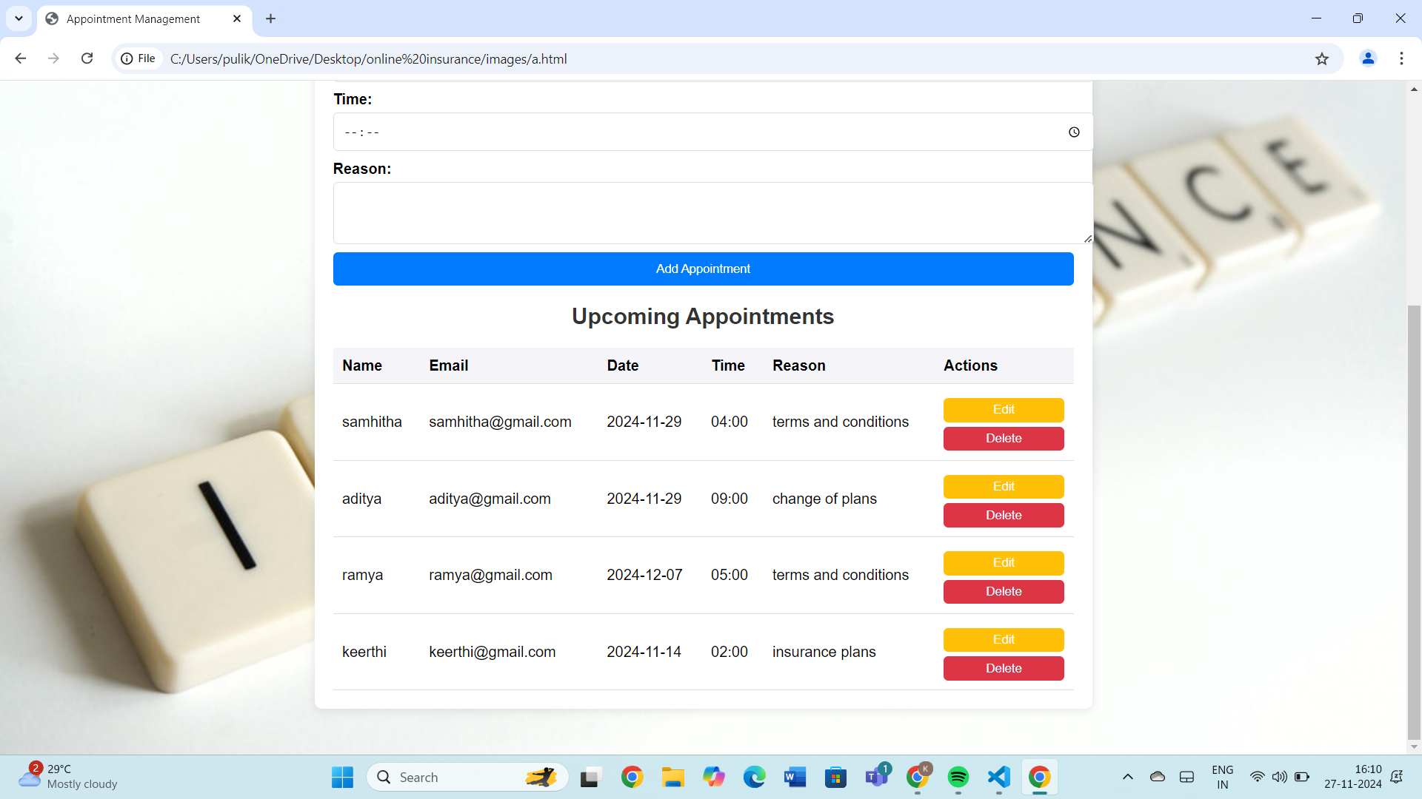

APPOINTMENT MANAGEMENT

Slide 23
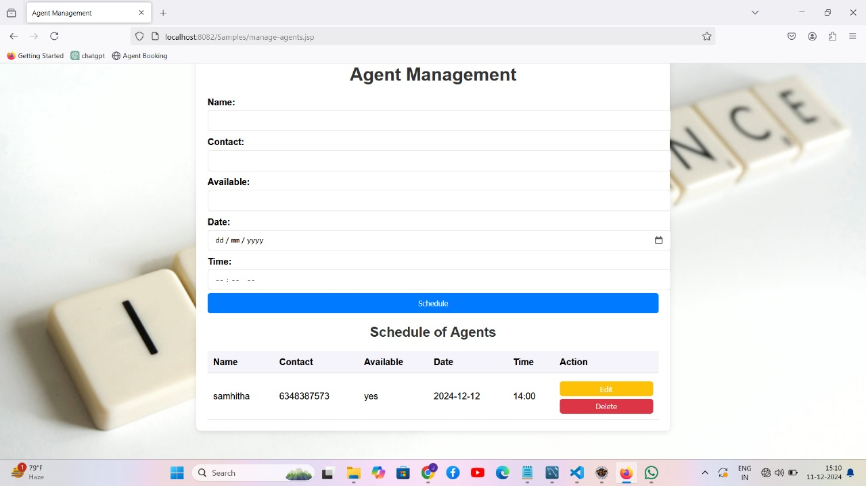
AGENT MANAGEMENT

Slide 24
CONCLUSION
Finally, this Online Insurance Web Application enables user-friendly and secure Application.
User can easily interact with it while viewing available agents, manage their appointments and can subscribe to their desired plans.
Admin can manage appointments and agents in the admin dashboard.

Slide 25

THANK YOU

